Slide 1
Chapter 9
Input Modeling
Banks, Carson, Nelson & Nicol
Discrete-Event System Simulation

Slide 2
Purpose & Overview
Input models provide the driving force for a simulation model.
The quality of the output is no better than the quality of inputs.
In this chapter, we will discuss the 4 steps of input model development:
  Collect data from the real system
  Identify a probability distribution to represent the input process
  Choose parameters for the distribution
  Evaluate the chosen distribution and parameters for goodness of fit.

Slide 3
Data Collection
One of the biggest tasks in solving a real problem
  GIGO: Garbage-In-Garbage-Out
System Performance Simulation
Raw Data
Input Data
Output
Even when model structure is valid simulation results can be misleading, if the input data is
  inaccurately collected
  inappropriately analyzed
  not representative of the environment

Slide 4
Data Collection
One of the biggest tasks in solving a real problem. GIGO – garbage-in-garbage-out
Suggestions that may enhance and facilitate data collection:
  Plan ahead: begin by a practice or pre-observing session, watch for unusual circumstances
  Analyze the data as it is being collected: check adequacy
  Combine homogeneous data sets, e.g. successive time periods, during the same time period on successive days
  Be aware of data censoring: the quantity is not observed in its entirety, danger of leaving out long process times
  Check for relationship between variables, e.g. build scatter diagram
  Check for autocorrelation
  Collect input data, not performance data

Slide 5
Identifying the Distribution
Histograms
Selecting families of distribution
Parameter estimation
Goodness-of-fit tests
Fitting a non-stationary process

Slide 6
Histograms [Identifying the distribution]
A frequency distribution or histogram is useful in determining the shape of a distribution
The number of class intervals depends on:
  The number of observations
  The dispersion of the data
  Suggested: the square root of the sample size
For continuous data:
  Corresponds to the probability density function of a theoretical distribution
For discrete data:
  Corresponds to the probability mass function
If few data points are available: combine adjacent cells to eliminate the ragged appearance of the histogram

Slide 7
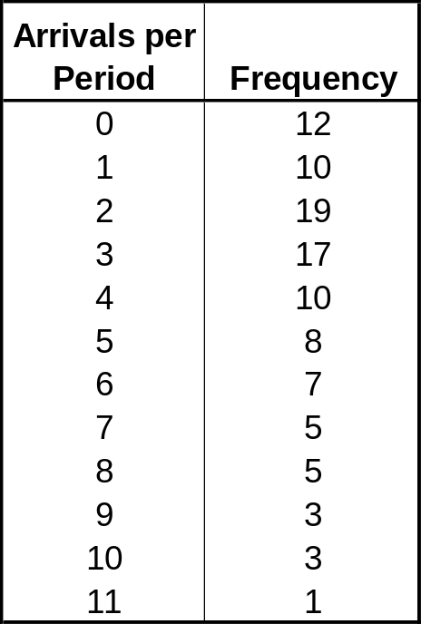
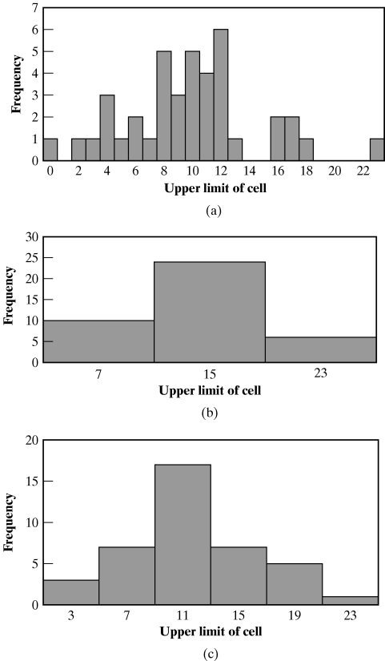
Histograms [Identifying the distribution]
Vehicle Arrival Example: # of vehicles arriving at an intersection between 7 am and 7:05 am was monitored for 100 random workdays.
There are ample data, so the histogram may have a cell for each possible value in the data range
Same data with different interval sizes

Slide 8
Histograms
A frequency distribution or histogram is useful in determining the shape of a distribution
The number of class intervals depends on:
  The number of observations
  The dispersion of the data
  Suggested number of intervals: the square root of the sample size
For continuous data:
  Corresponds to the probability density function (pdf) of a theoretical distribution
For discrete data:
  Corresponds to the probability mass function (pmf)
If few data points are available
  combine adjacent cells to eliminate the ragged appearance of the histogram

Slide 9
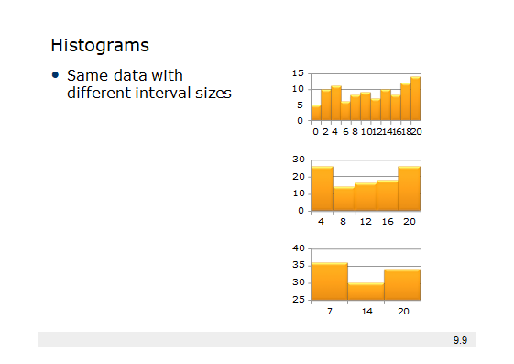

Slide 10
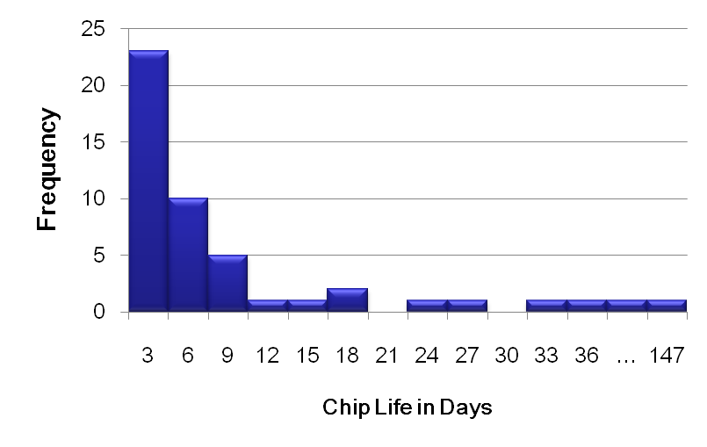
Histograms: Example
Life tests were performed on electronic components at 1.5 times the nominal voltage, and their lifetime was recorded
Component Life | Frequency
0 ≤ x < 3 | 23
3 ≤ x < 6 | 10
6 ≤ x < 9 | 5
9 ≤ x < 12 | 1
12 ≤ x < 15 | 1
…
42 ≤ x < 45 | 1
…
144 ≤ x < 147 | 1

Slide 11
Histograms: Example
Histogram
Histogram
Histogram
Sample size 10000
Histograms with different numbers of bins
−6 −4 −2 0 2 4 6
−6 −4 −2 0 2 4 6
−6 −4 −2 0 2 4 6
#Bins 5
#Bins 10
#Bins 20
Histogram
Histogram
Histogram
−6 | −4 −2 0 2 | 4 | 6 | −6 | −4 −2 0 2 | 4 | 6 | −6 | −4 −2 0 2 | 4 | 6
 | #Bins 50 |  |  |  | #Bins 100 |  |  |  | #Bins 200

Slide 12
Selecting the Family of Distributions
[Identifying the distribution]
A family of distributions is selected based on:
  The context of the input variable
  Shape of the histogram
Frequently encountered distributions:
  Easier to analyze: exponential, normal and Poisson
  Harder to analyze: beta, gamma and Weibull

Slide 13
Selecting the Family of Distributions
[Identifying the distribution]
Use the physical basis of the distribution as a guide, for example:
  Binomial: # of successes in n trials
  Poisson: # of independent events that occur in a fixed amount of time or space
  Normal: dist’n of a process that is the sum of a number of component processes
  Exponential: time between independent events, or a process time that is memoryless
  Weibull: time to failure for components
  Discrete or continuous uniform: models complete uncertainty
  Triangular: a process for which only the minimum, most likely, and maximum values are known
  Empirical: resamples from the actual data collected

Slide 14
Selecting the Family of Distributions
[Identifying the distribution]
Remember the physical characteristics of the process
  Is the process naturally discrete or continuous valued?
  Is it bounded?
No “true” distribution for any stochastic input process
Goal: obtain a good approximation

Slide 15
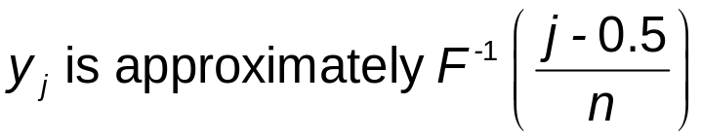
Quantile-Quantile Plots [Identifying the distribution]
Q-Q plot is a useful tool for evaluating distribution fit
If X is a random variable with cdf F, then the q-quantile of X is the γ such that
  When F has an inverse, γ = F⁻¹(q)
Let {x_{i}, i = 1,2, …., n} be a sample of data from X and {y_{j}, j = 1,2, …, n} be the observations in ascending order:
  where j is the ranking or order number

Slide 16
Quantile-Quantile Plots [Identifying the distribution]
The plot of y_{j} versus F⁻¹( (j-0.5)/n) is
  Approximately a straight line if F is a member of an appropriate family of distributions
  The line has slope 1 if F is a member of an appropriate family of distributions with appropriate parameter values

Slide 17
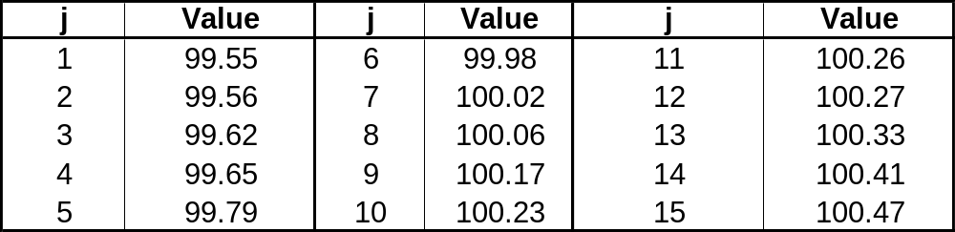
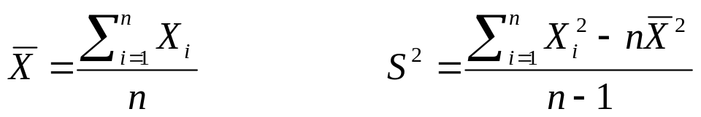
Quantile-Quantile Plots [Identifying the distribution]
Example: Check whether the door installation times follows a normal distribution.
  The observations are now ordered from smallest to largest:
  y_{j} are plotted versus F⁻¹( (j-0.5)/n) where F has a normal distribution with the sample mean (99.99 sec) and sample variance (0.2832² sec²)

Slide 18
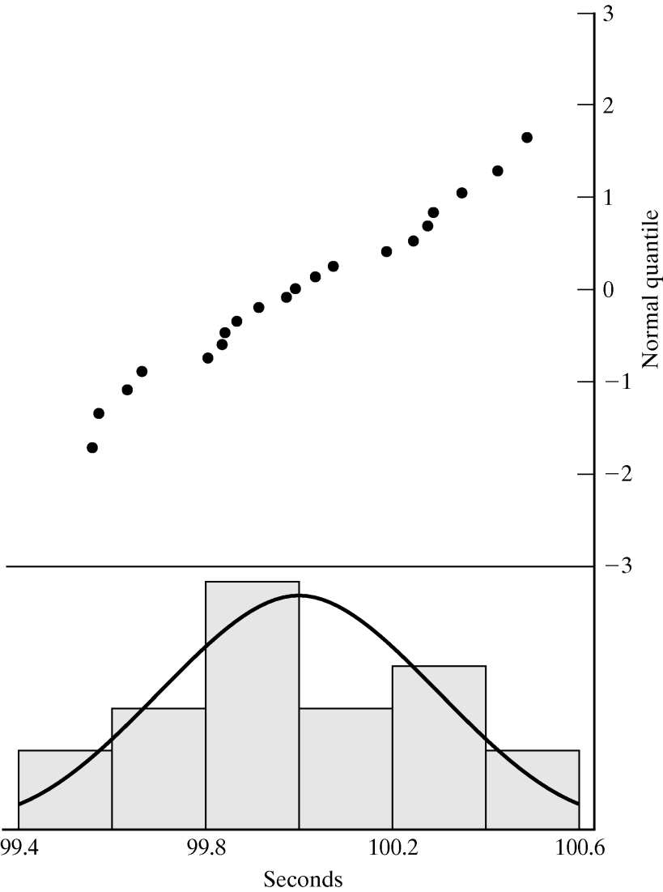
Quantile-Quantile Plots [Identifying the distribution]
Example (continued): Check whether the door installation times follow a normal distribution.
Straight line, supporting the hypothesis of a normal distribution
Superimposed density function of the normal distribution

Slide 19
Quantile-Quantile Plots [Identifying the distribution]
Consider the following while evaluating the linearity of a q-q plot:
  The observed values never fall exactly on a straight line
  The ordered values are ranked and hence not independent, unlikely for the points to be scattered about the line
  Variance of the extremes is higher than the middle. Linearity of the points in the middle of the plot is more important.
Q-Q plot can also be used to check homogeneity
  Check whether a single distribution can represent both sample sets
  Plotting the order values of the two data samples against each other

Slide 20
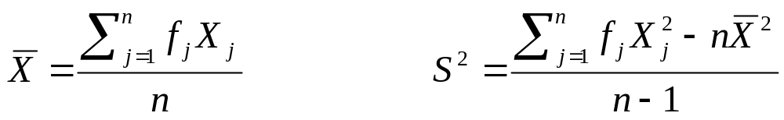
Parameter Estimation [Identifying the distribution]
Next step after selecting a family of distributions
If observations in a sample of size n are X₁, X₂, …, X_{n} (discrete or continuous), the sample mean and variance are:
If the data are discrete and have been grouped in a frequency distribution:
where f_{j} is the observed frequency of value X_{j}

Slide 21
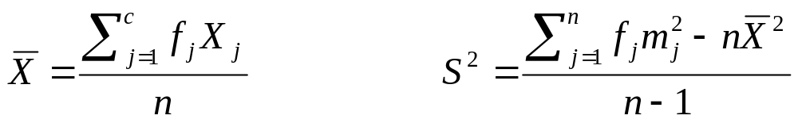
Parameter Estimation [Identifying the distribution]
When raw data are unavailable (data are grouped into class intervals), the approximate sample mean and variance are:
where f_{j} is the observed frequency of in the jth class interval
m_{j} is the midpoint of the jth interval, and c is the number of class intervals
A parameter is an unknown constant, but an estimator is a statistic.

Slide 22
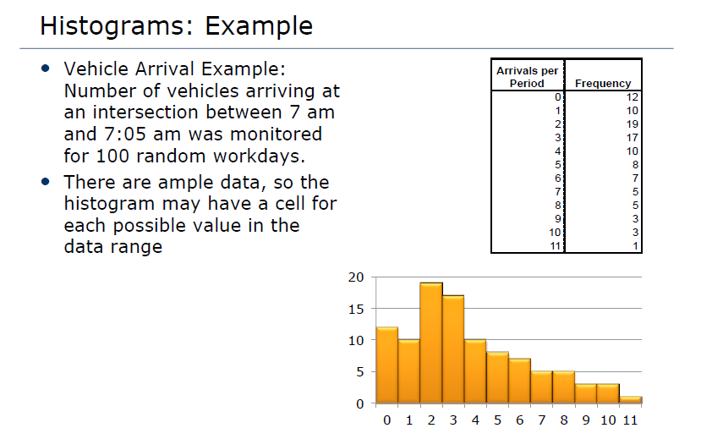

Slide 23
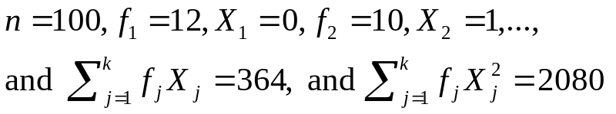
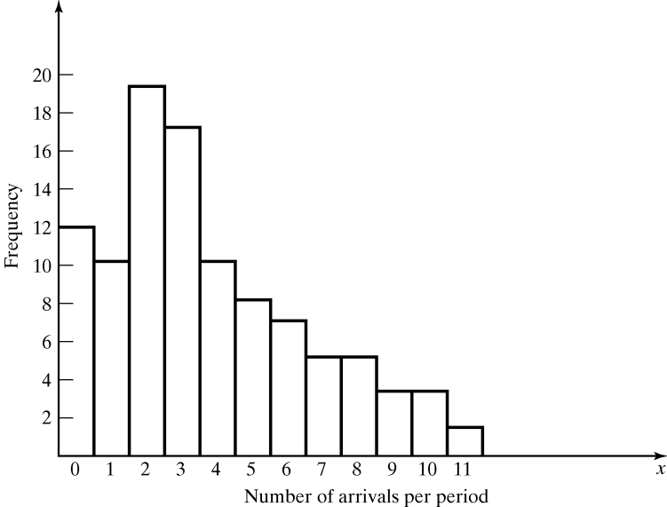
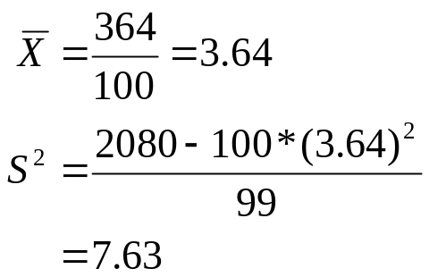
Parameter Estimation [Identifying the distribution]
Vehicle Arrival Example (continued): Table in the histogram example on slide 6 (Table 9.1 in book) can be analyzed to obtain:
  The sample mean and variance are
  The histogram suggests X to have a Possion distribution
    However, note that sample mean is not equal to sample variance.
    Reason: each estimator is a random variable, is not perfect.

Slide 24
Goodness-of-Fit Tests [Identifying the distribution]
Conduct hypothesis testing on input data distribution using:
  Kolmogorov-Smirnov test
  Chi-square test
No single correct distribution in a real application exists.
  If very little data are available, it is unlikely to reject any candidate distributions
  If a lot of data are available, it is likely to reject all candidate distributions

Slide 25
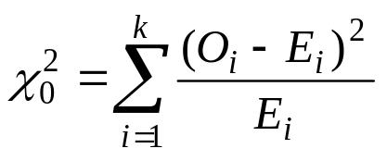
Chi-Square test [Goodness-of-Fit Tests]
Intuition: comparing the histogram of the data to the shape of the candidate density or mass function
Valid for large sample sizes when parameters are estimated by maximum likelihood
By arranging the n observations into a set of k class intervals or cells, the test statistics is:
  which approximately follows the chi-square distribution with k-s-1 degrees of freedom, where s = # of parameters of the hypothesized distribution estimated by the sample statistics.
Expected Frequency
E_{i} = n*p_{i}
where p_{i} is the theoretical prob. of the ith interval.
Suggested Minimum = 5
Observed Frequency

Slide 26

Chi-Square test [Goodness-of-Fit Tests]
The hypothesis of a chi-square test is:
H₀: The random variable, X, conforms to the distributional assumption with the parameter(s) given by the estimate(s).
H₁: The random variable X does not conform.
If the distribution tested is discrete and combining adjacent cell is not required (so that E_{i} > minimum requirement):
  Each value of the random variable should be a class interval, unless combining is necessary, and

Slide 27
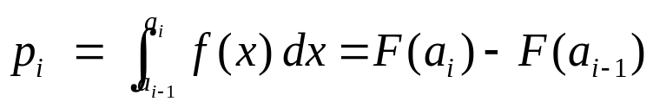
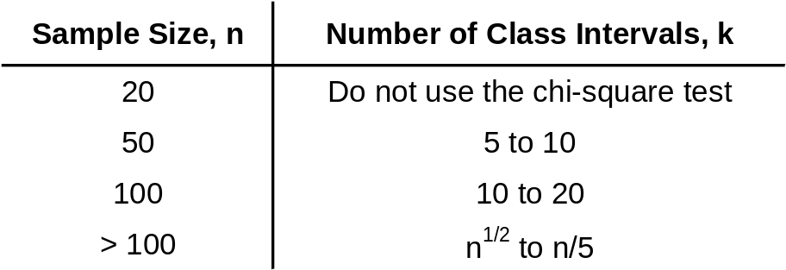
Chi-Square test [Goodness-of-Fit Tests]
If the distribution tested is continuous:
  where a_{i}-1 and a_{i} are the endpoints of the i^{th} class interval
  and f(x) is the assumed pdf, F(x) is the assumed cdf.
  Recommended number of class intervals (k):
  Caution: Different grouping of data (i.e., k) can affect the hypothesis testing result.

Slide 28
Parameter Estimation
Maximum-Likelihood Estimators (MLE)
Suggested estimators for distributions often used in simulation
Distribution | Parameter | Estimator
Poisson | α | αˆ = X
Exponential | λ | λ^{ˆ} = ¹ X
Gamma | β, θ | θ^{ˆ} = ¹ X
Normal | μ, σ² | μˆ = X ,σˆ ² = S ²
Lognormal | μ, σ² | μˆ = X ,σˆ ² = S ²
After taking ln
of data.
9.<number>

Slide 29
Goodness-of-Fit Tests
Be aware of mistakes in decision finding
  Type I Error: α
    Error of first kind, False positive
    Reject H₀ when it is true
  Type II Error: β
    Error of second kind, False negative
    Retain H₀ when it is not true
Statistical Decision | State of the null hypothesis
 | H₀ True | H₀ False
Accept H₀ | Correct | Type II Error Incorrectly accept H₀ False negative
Reject H₀ | Type I Error Incorrectly reject H₀ False positive | Correct
9.<number>

Slide 30
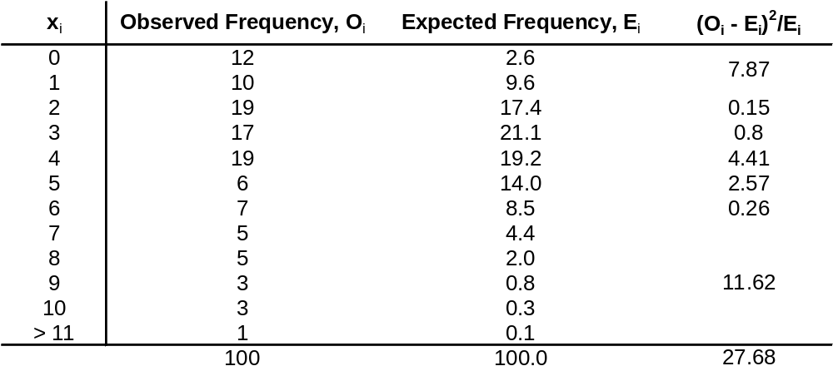
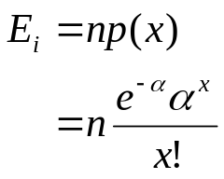
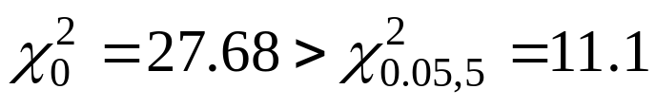
Chi-Square test [Goodness-of-Fit Tests]
Vehicle Arrival Example (continued):
H₀: the random variable is Poisson distributed.
H₁: the random variable is not Poisson distributed.
  Degree of freedom is k-s-1 = 7-1-1 = 5, hence, the hypothesis is rejected at the 0.05 level of significance.
Combined because of min E_{i}

Slide 31
Kolmogorov-Smirnov Test
[Goodness-of-Fit Tests]
Intuition: formalize the idea behind examining a q-q plot
Recall from Chapter 7.4.1:
  The test compares the continuous cdf, F(x), of the hypothesized distribution with the empirical cdf, S_{N}(x), of the N sample observations.
  Based on the maximum difference statistics (Tabulated in A.8):
  D = max| F(x) - S_{N}(x)|
A more powerful test, particularly useful when:
  Sample sizes are small,
  No parameters have been estimated from the data.
When parameter estimates have been made:
  Critical values in Table A.8 are biased, too large.
  More conservative, i.e., smaller Type I error than specified.

Slide 32

p-Values and “Best Fits”
[Goodness-of-Fit Tests]
p-value for the test statistics
  The significance level at which one would just reject H₀ for the given test statistic value.
  A measure of fit, the larger the better
  Large p-value: good fit
  Small p-value: poor fit
Vehicle Arrival Example (cont.):
  H₀: data is Possion
  Test statistics: , with 5 degrees of freedom
  p-value = 0.00004, meaning we would reject H₀ with 0.00004 significance level, hence Poisson is a poor fit.

Slide 33
p-Values and “Best Fits”
Hypothesis testing requires a significance level
  Significance level (α) is the probability of falsely rejecting H₀
  Common significance levels
    α = 0.1
    α = 0.05
    α = 0.01
Be aware that significance level does not tell anything about the subject of the test!
Generalization of the significance level: p-value
Reject H0
Fail to reject H0
Reject H0
9.<number>

Slide 34
p-Values and “Best Fits”
[Goodness-of-Fit Tests]
Many software use p-value as the ranking measure to automatically determine the “best fit”. Things to be cautious about:
  Software may not know about the physical basis of the data, distribution families it suggests may be inappropriate.
  Close conformance to the data does not always lead to the most appropriate input model.
  p-value does not say much about where the lack of fit occurs
Recommended: always inspect the automatic selection using graphical methods.

Slide 35
Selecting Model without Data
If data is not available, some possible sources to obtain information about the process are:
  Engineering data: often product or process has performance ratings provided by the manufacturer or company rules specify time or production standards.
  Expert option: people who are experienced with the process or similar processes, often, they can provide optimistic, pessimistic and most-likely times, and they may know the variability as well.
  Physical or conventional limitations: physical limits on performance, limits or bounds that narrow the range of the input process.
  The nature of the process.
The uniform, triangular, and beta distributions are often used as input models.

Slide 36
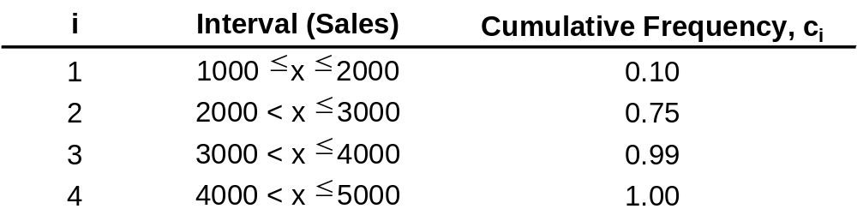
Selecting Model without Data
Example: Production planning simulation.
  Input of sales volume of various products is required, salesperson of product XYZ says that:
    No fewer than 1,000 units and no more than 5,000 units will be sold.
    Given her experience, she believes there is a 90% chance of selling more than 2,000 units, a 25% chance of selling more than 2,500 units, and only a 1% chance of selling more than 4,500 units.
  Translating these information into a cumulative probability of being less than or equal to those goals for simulation input:

Slide 37
Multivariate and Time-Series Input Models
Multivariate:
  For example, lead time and annual demand for an inventory model, increase in demand results in lead time increase, hence variables are dependent.
Time-series:
  For example, time between arrivals of orders to buy and sell stocks, buy and sell orders tend to arrive in bursts, hence, times between arrivals are dependent.

Slide 38

Covariance and Correlation
[Multivariate/Time Series]
Consider the model that describes relationship between X₁ and X₂:
  β = 0, X₁ and X₂ are statistically independent
  β > 0, X₁ and X₂ tend to be above or below their means together
  β < 0, X₁ and X₂ tend to be on opposite sides of their means
Covariance between X₁ and X₂ :
    = 0, = 0
  where cov(X₁, X₂) < 0, then β < 0
  > 0, > 0
ε is a random variable with mean 0 and is independent of X₂

Slide 39
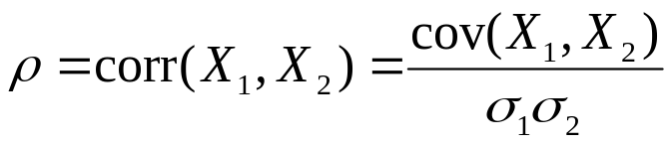
Covariance and Correlation
[Multivariate/Time Series]
Correlation between X₁ and X₂ (values between -1 and 1):
    = 0, = 0
  where corr(X₁, X₂) < 0, then β < 0
  > 0, > 0
  The closer ρ is to -1 or 1, the stronger the linear relationship is between X₁ and X₂.

Slide 40
Covariance and Correlation
[Multivariate/Time Series]
A time series is a sequence of random variables X₁, X₂, X₃, … , are identically distributed (same mean and variance) but dependent.
  cov(X_{t}, X_{t+h}) is the lag-h autocovariance
  corr(X_{t}, X_{t+h}) is the lag-h autocorrelation
  If the autocovariance value depends only on h and not on t, the time series is covariance stationary

Slide 41
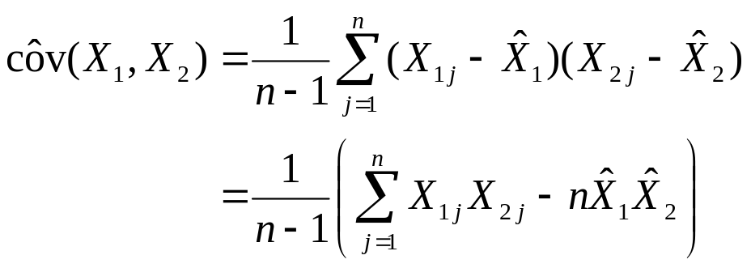
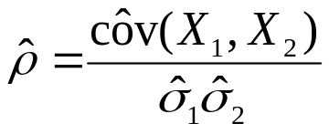
Multivariate Input Models
[Multivariate/Time Series]
If X₁ and X₂ are normally distributed, dependence between them can be modeled by the bivariate normal distribution with μ₁, μ₂, σ₁², σ₂² and correlation ρ
  To Estimate μ₁, μ₂, σ₁², σ₂², see “Parameter Estimation” (slide 15- 17, Section 9.3.2 in book)
  To Estimate ρ, suppose we have n independent and identically distributed pairs (X₁₁, X₂₁), (X₁₂, X₂₂), … (X_{1n}, X_{2n}), then:
Sample deviation

Slide 42
Time-Series Input Models
[Multivariate/Time Series]
If X₁, X₂, X₃,… is a sequence of identically distributed, but dependent and covariance-stationary random variables, then we can represent the process as follows:
  Autoregressive order-1 model, AR(1)
  Exponential autoregressive order-1 model, EAR(1)
    Both have the characteristics that:
    Lag-h autocorrelation decreases geometrically as the lag increases, hence, observations far apart in time are nearly independent

Slide 43
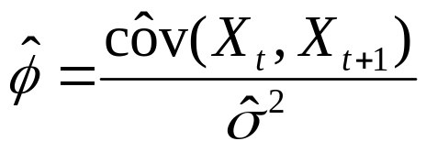

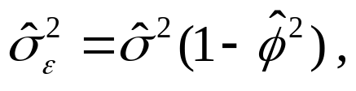
AR(1) Time-Series Input Models
[Multivariate/Time Series]
Consider the time-series model:
If X₁ is chosen appropriately, then
  X₁, X₂, … are normally distributed with mean = μ, and variance = σ²/(1-φ²)
  Autocorrelation ρ_{h} = φ^{h}
To estimate φ, μ, σ_{ε}² :

Slide 44
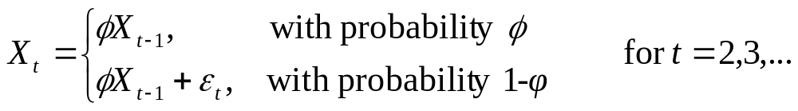
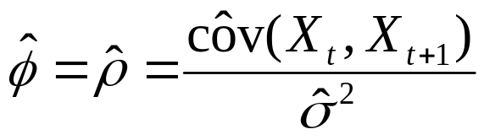
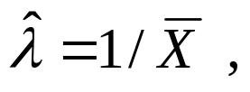
EAR(1) Time-Series Input Models
[Multivariate/Time Series]
Consider the time-series model:
If X₁ is chosen appropriately, then
  X₁, X₂, … are exponentially distributed with mean = 1/λ
  Autocorrelation ρ_{h} = φ^{h} , and only positive correlation is allowed.
To estimate φ, λ :

Slide 45
Summary
In this chapter, we described the 4 steps in developing input data models:
  Collecting the raw data
  Identifying the underlying statistical distribution
  Estimating the parameters
  Testing for goodness of fit

